Slide 1
Chapter 3: Differential Kinematics of Serial Robot: Velocity Analysis.

Slide 2
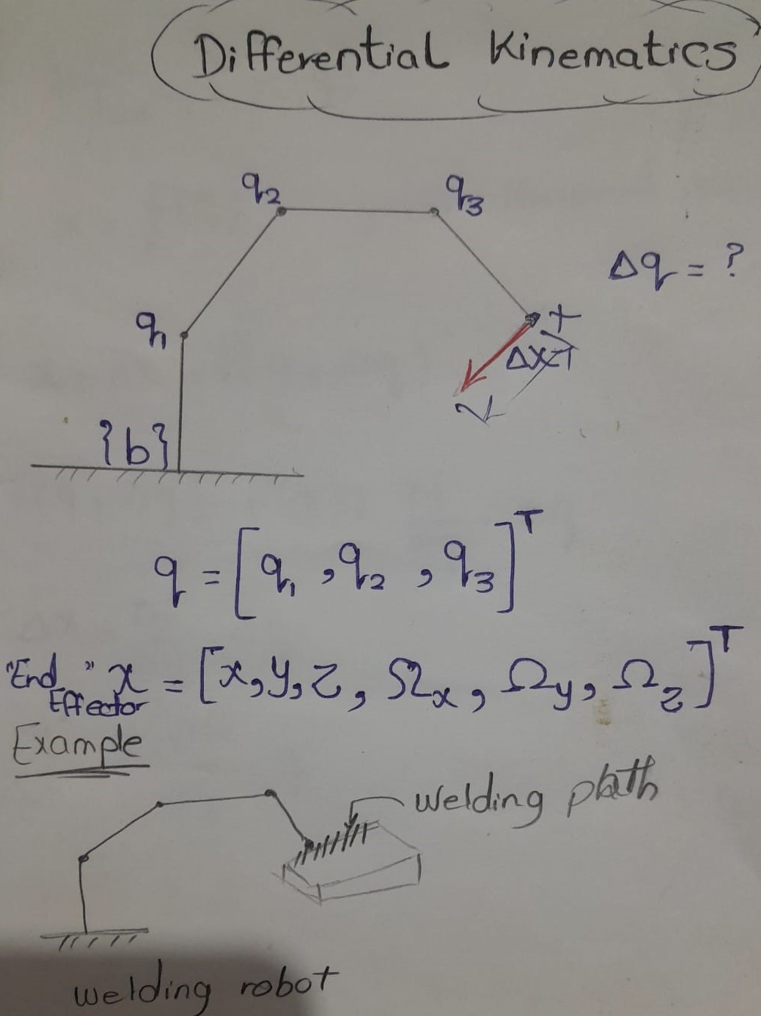

Slide 3
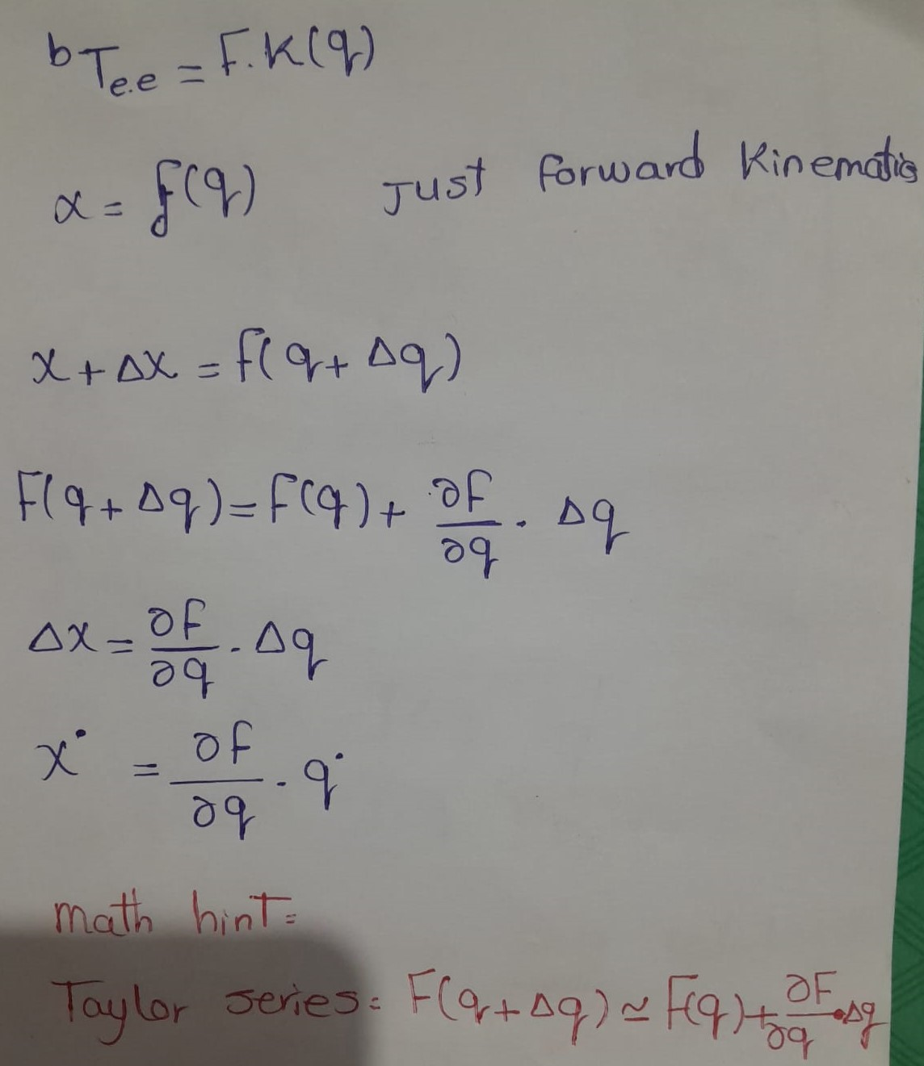

Slide 4
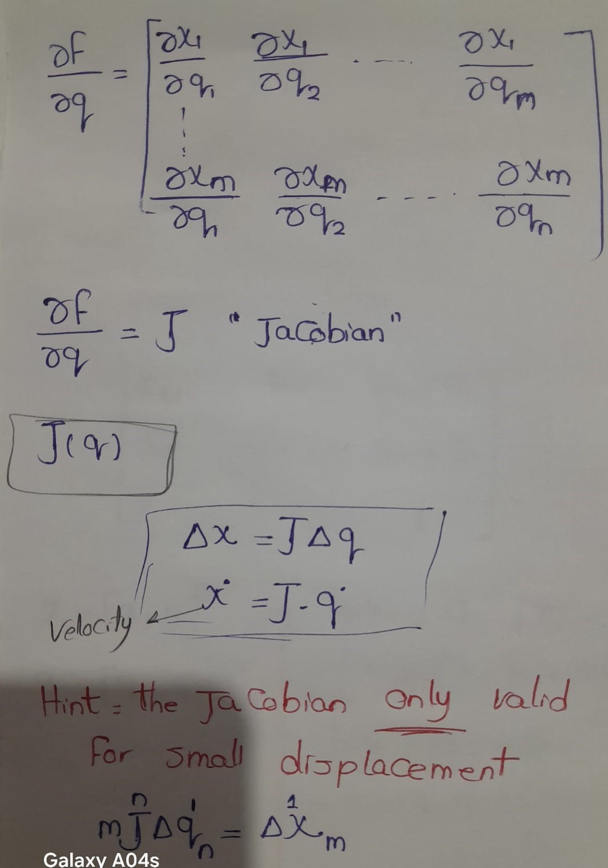

Slide 5
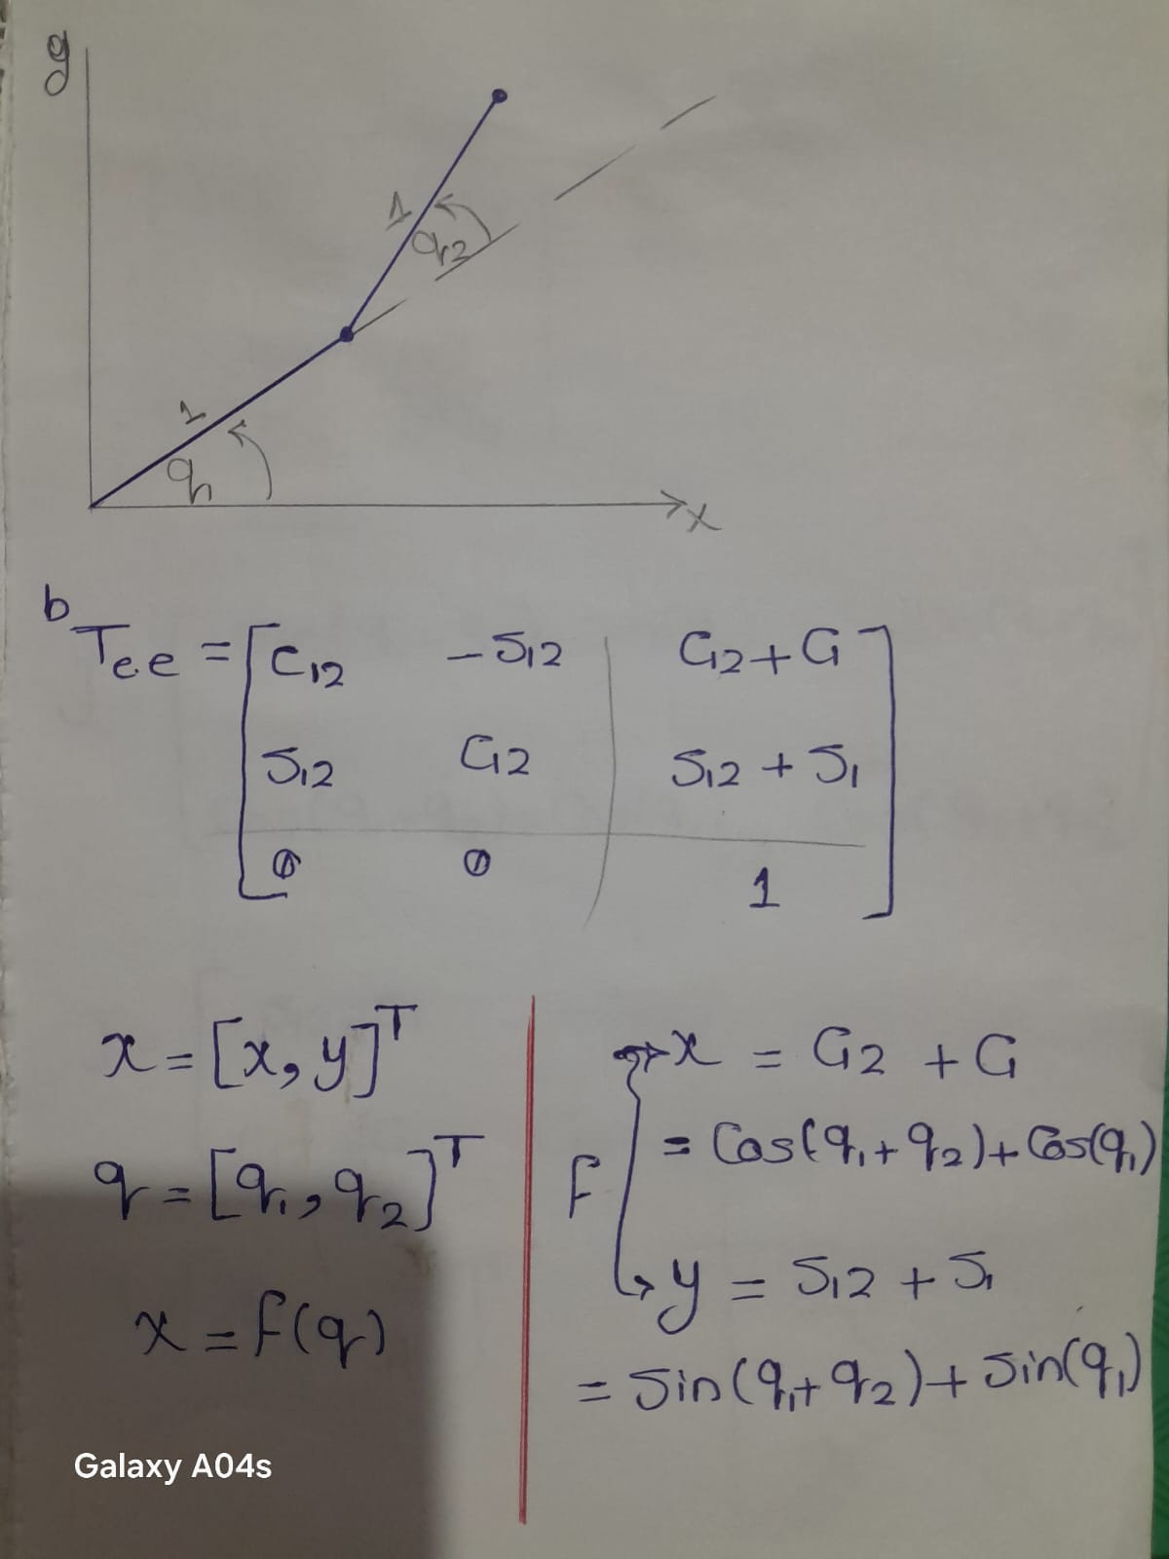

Slide 6
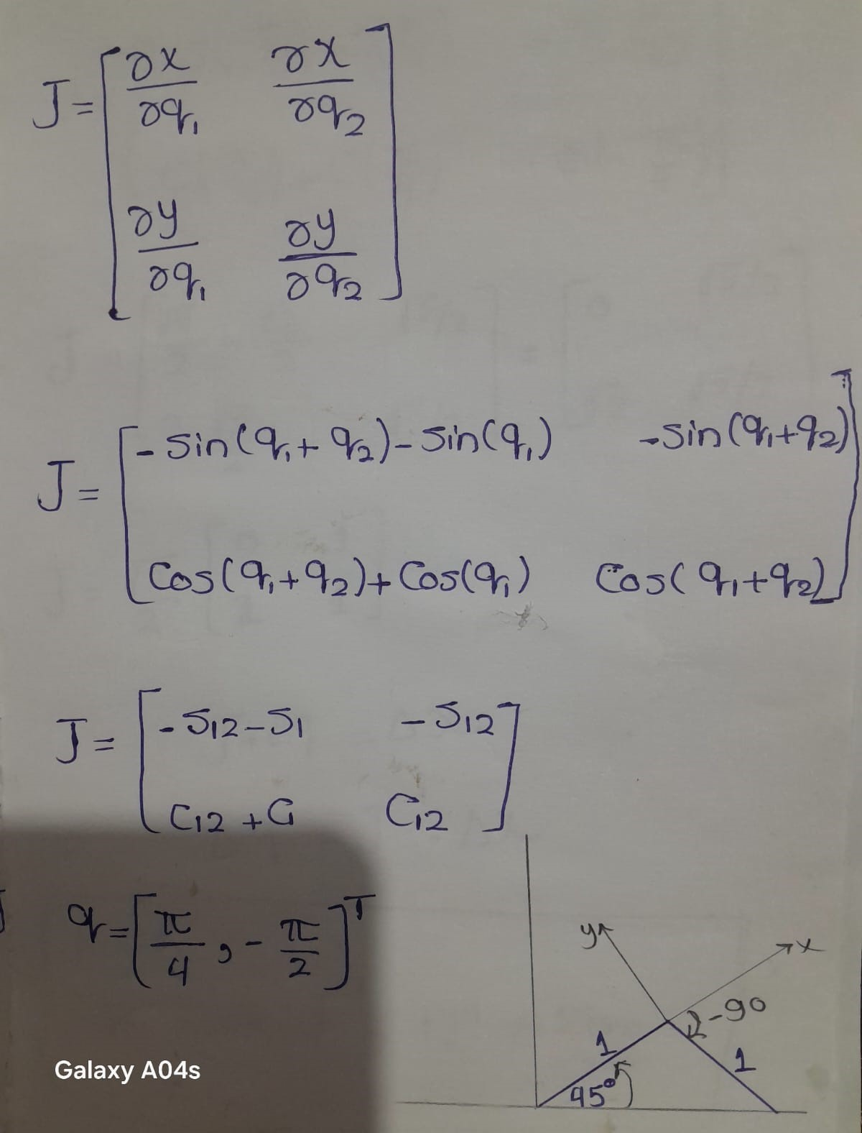

Slide 7
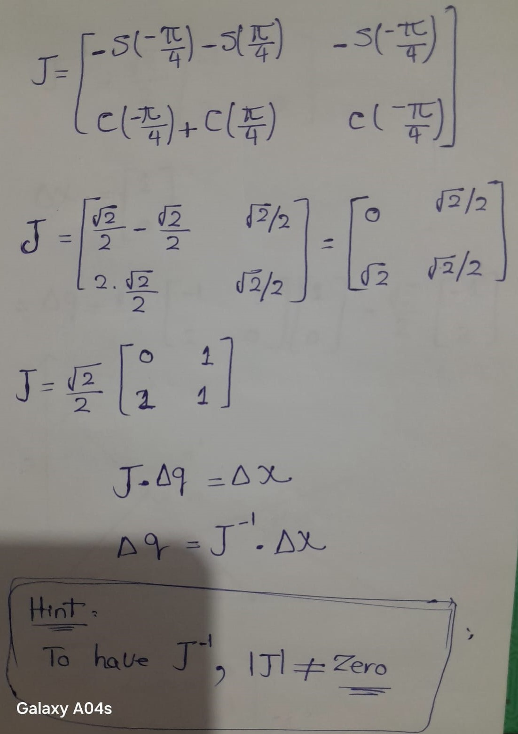

Slide 8
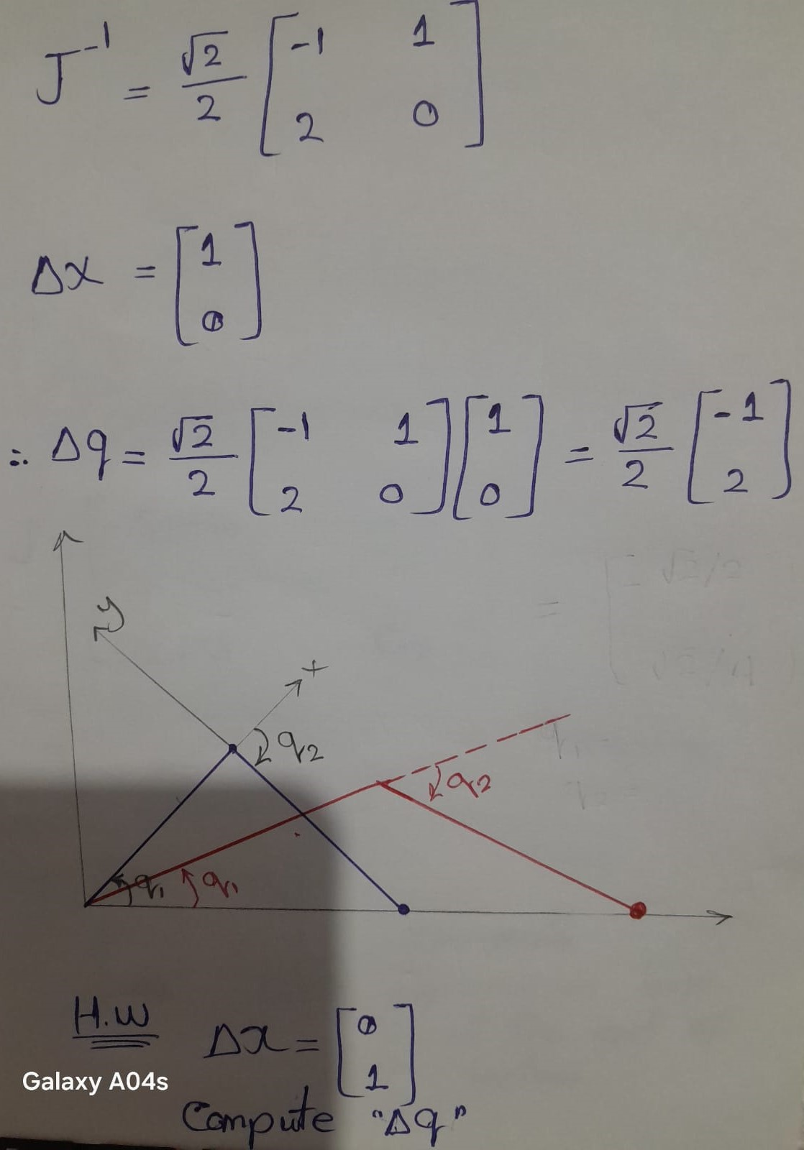

Slide 9
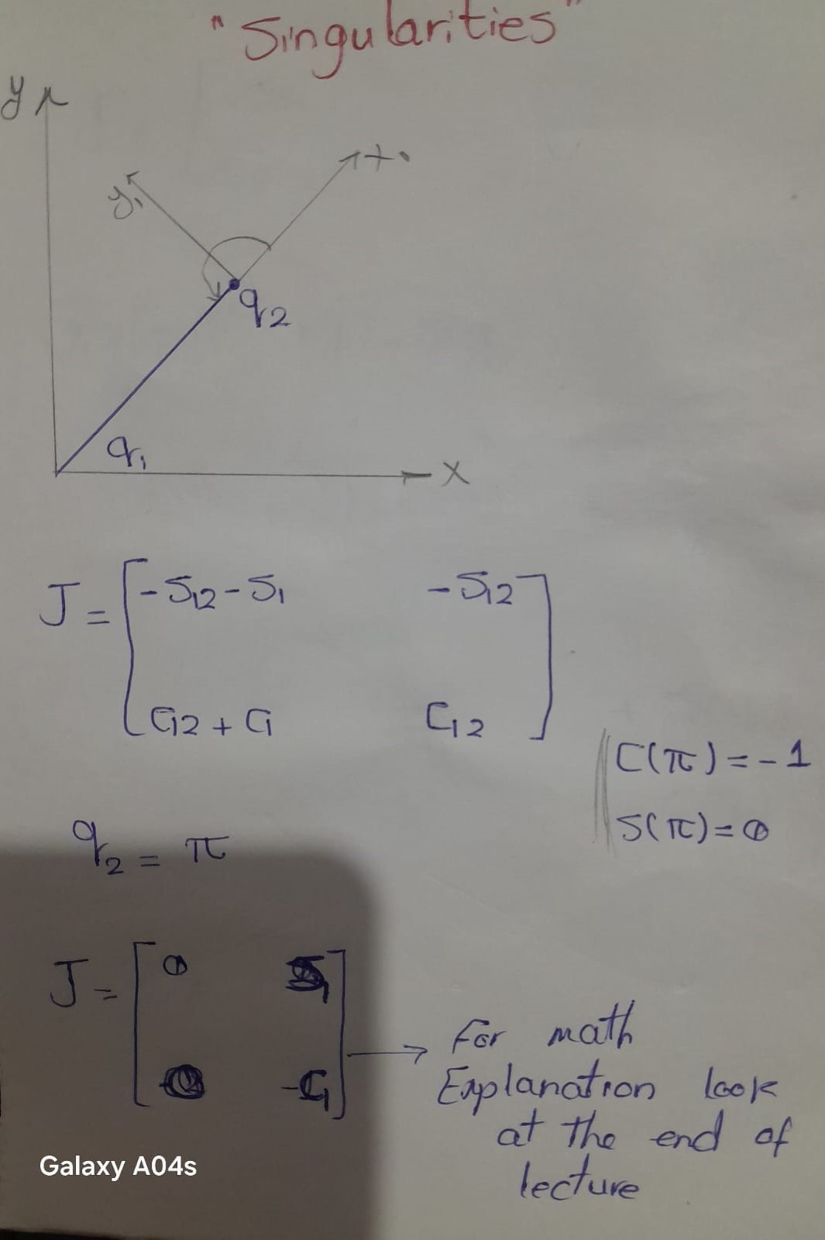

Slide 10
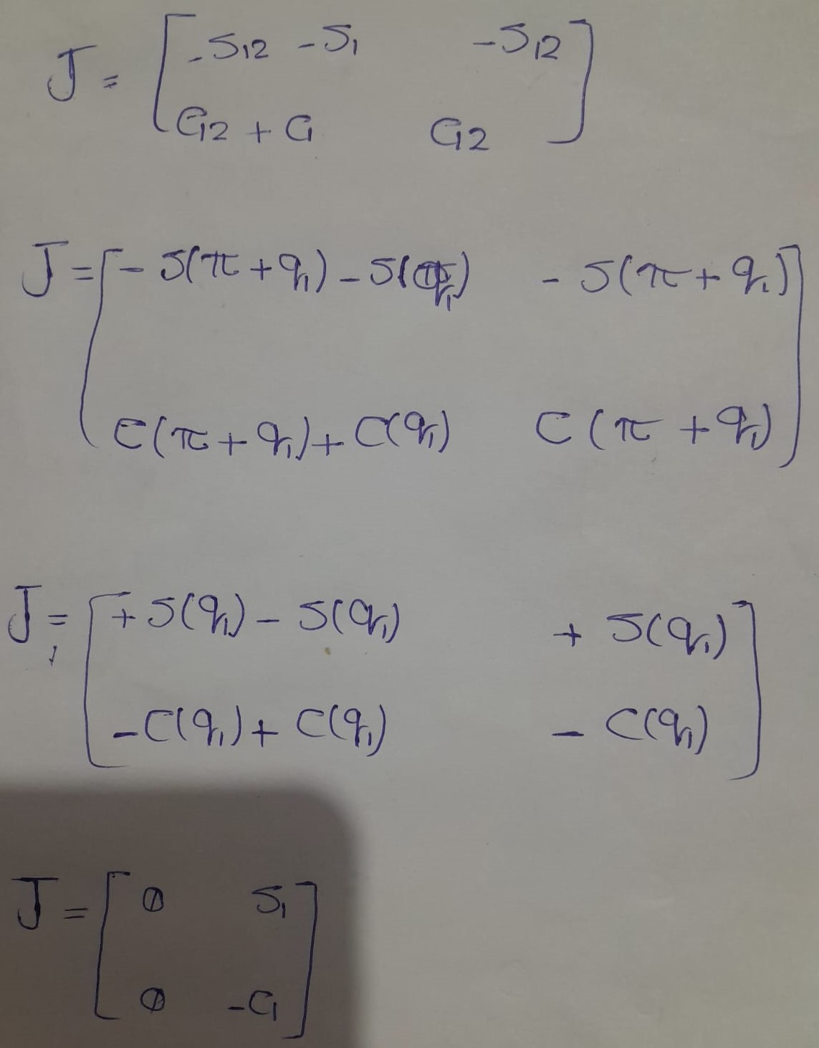

Slide 11
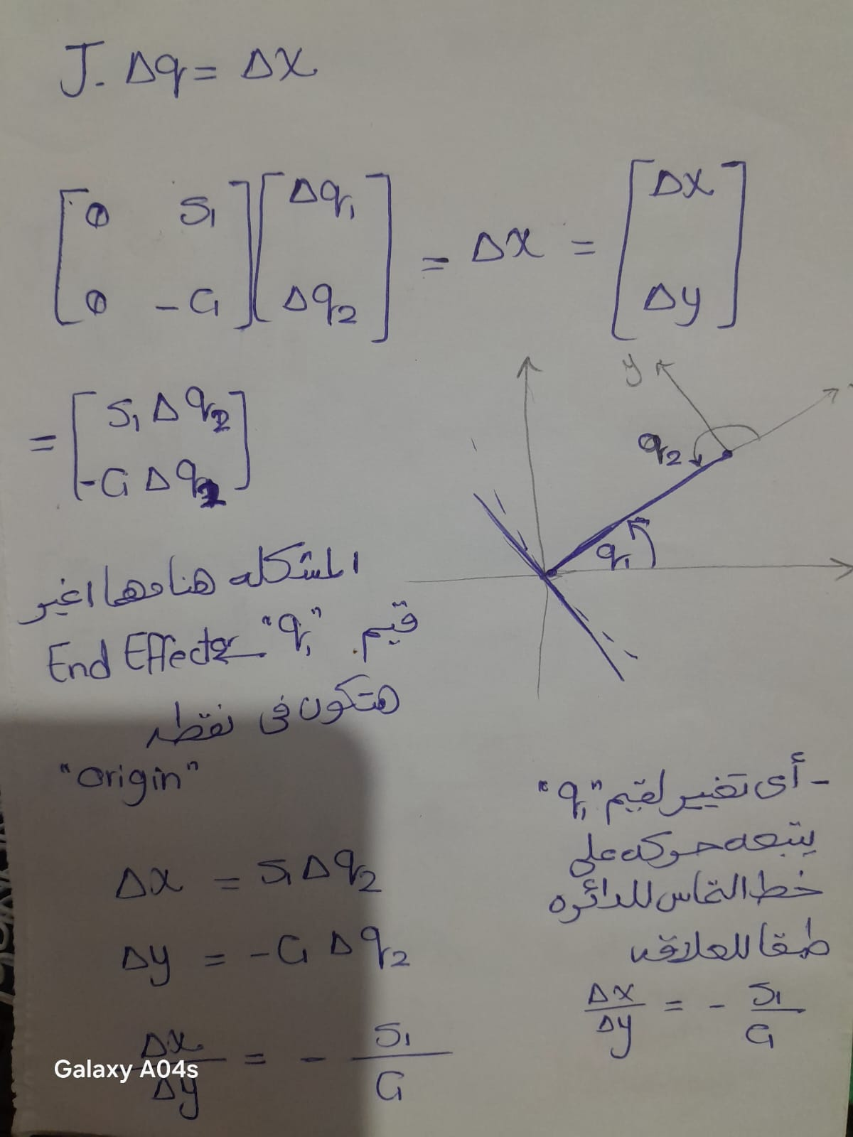

Slide 12
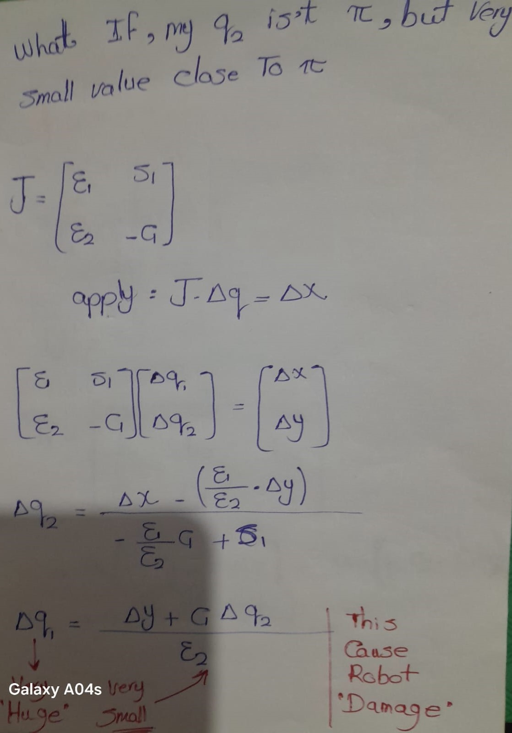

Slide 13
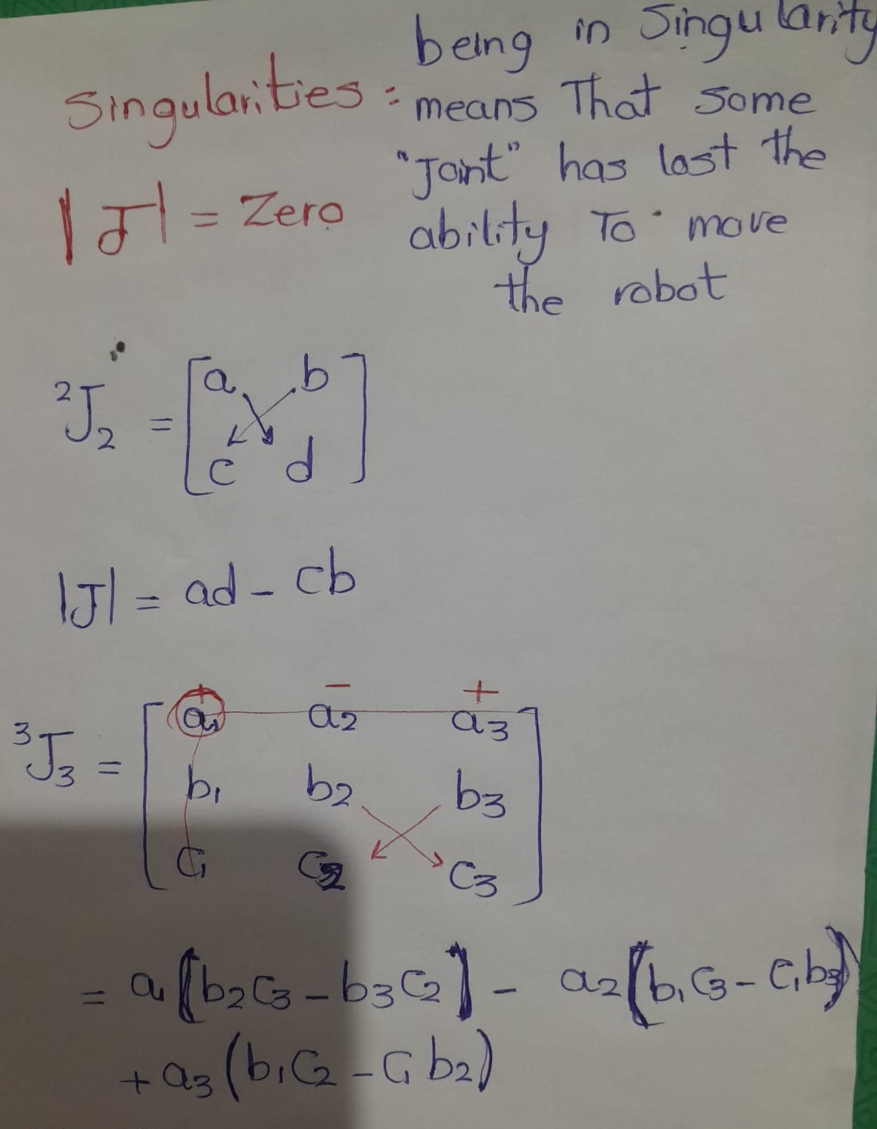

Slide 14
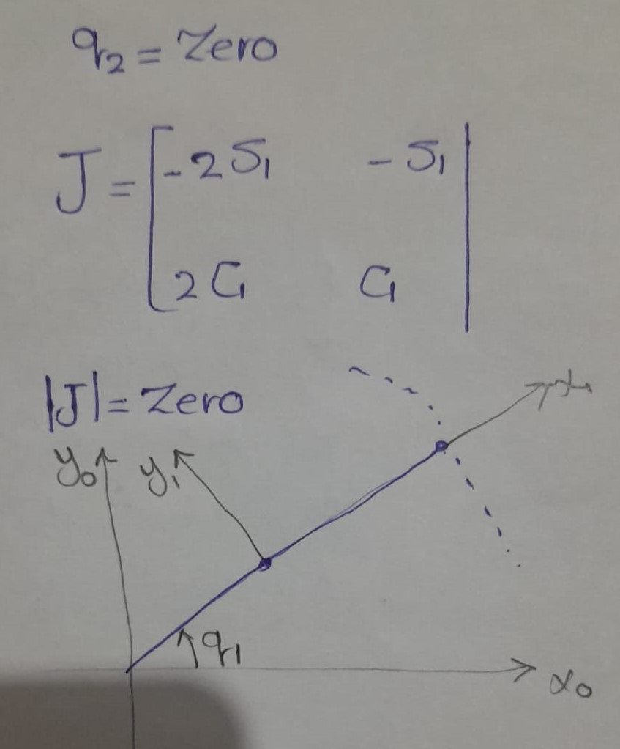

Slide 15
Singularity refers to a condition where a robot arm loses its ability to move freely and precisely due to limitations in its mechanical design. It arises typically when a robot arm reaches a certain configuration where its joints align in a way that prevents smooth, continuous motion.
Wrist singularity | Elbow singularity
Occurs when the robot’s wrist joints align in a way that limits the wrist’s motion. | Arises when the robot’s elbow joint becomes locked in a certain configuration, rendering it unable to extend or retract fully.
Are often characterized by a loss of one degree of freedom in the wrist, making precise maneuvers difficult. | Usually results in a reduced working range for the robot arm.
Can be especially problematic when the robot needs to manipulate objects at different angles and orientations. | Can have implications for tasks that require extending the arm fully or navigating through tight spaces.

Slide 16
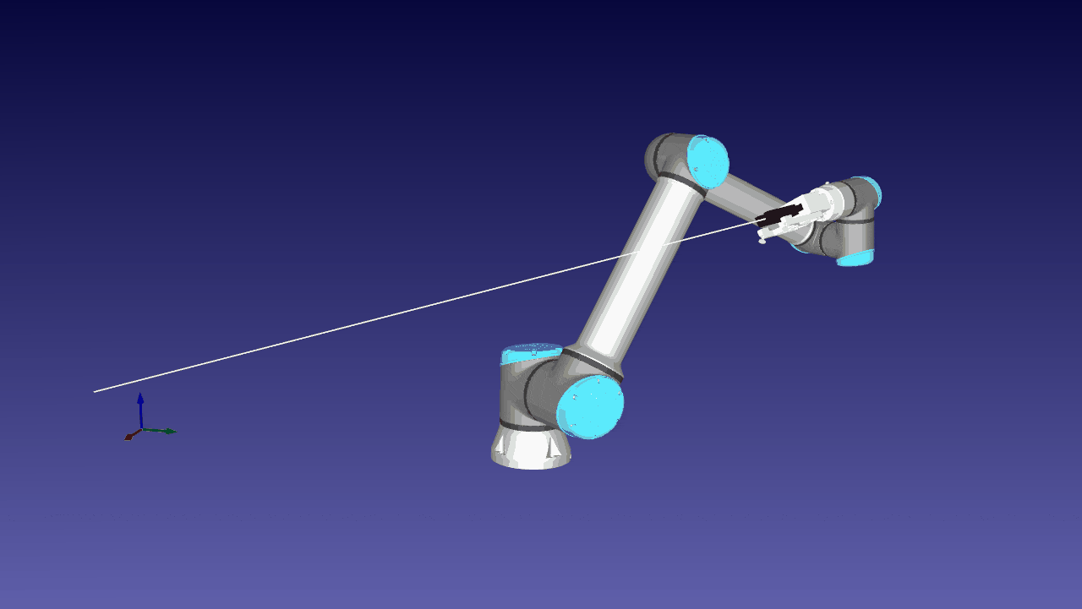
Wrist singularity

Slide 17
Differential Kinematics Example

Slide 18
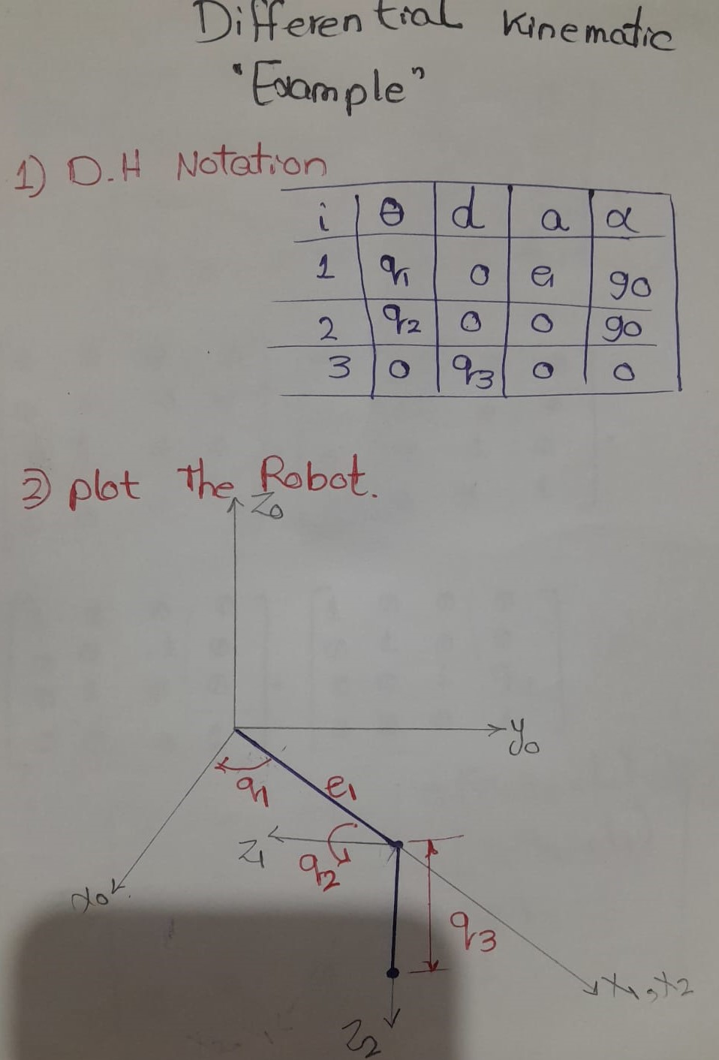

Slide 19
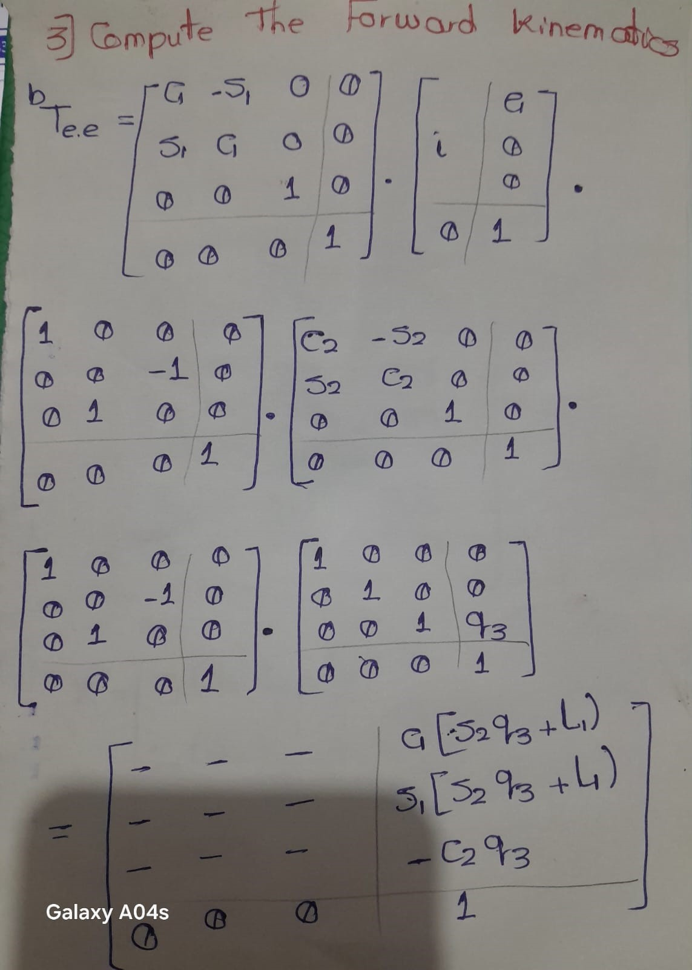

Slide 20
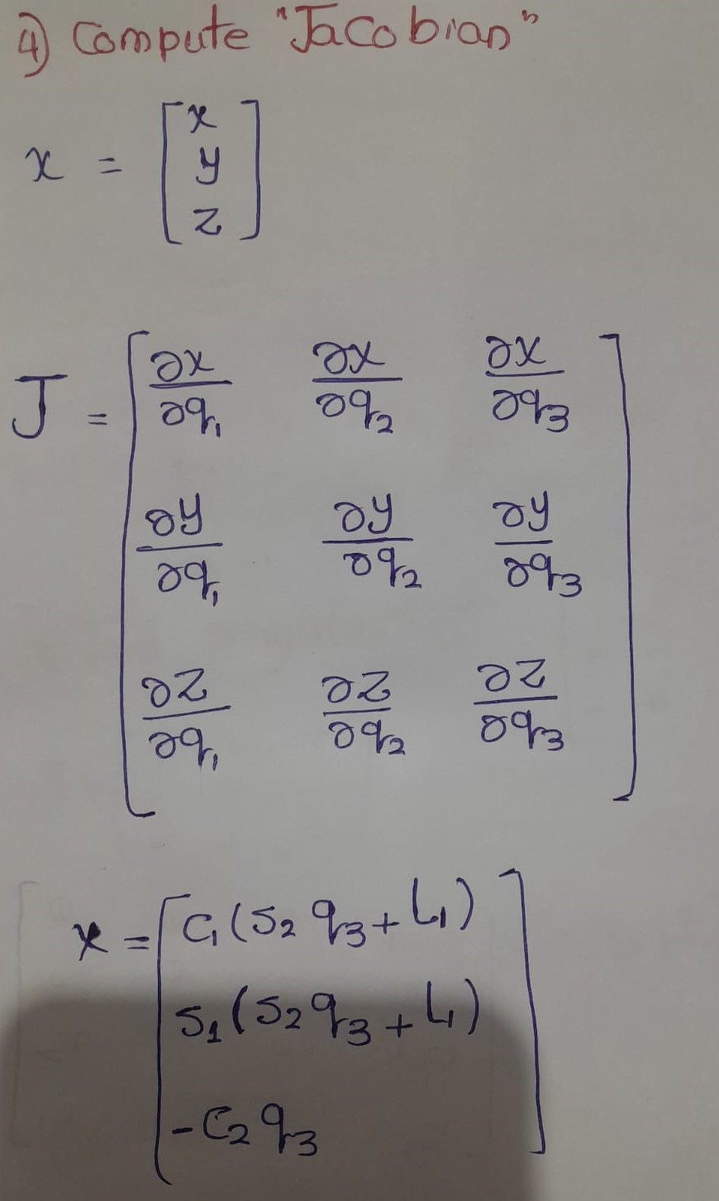

Slide 21
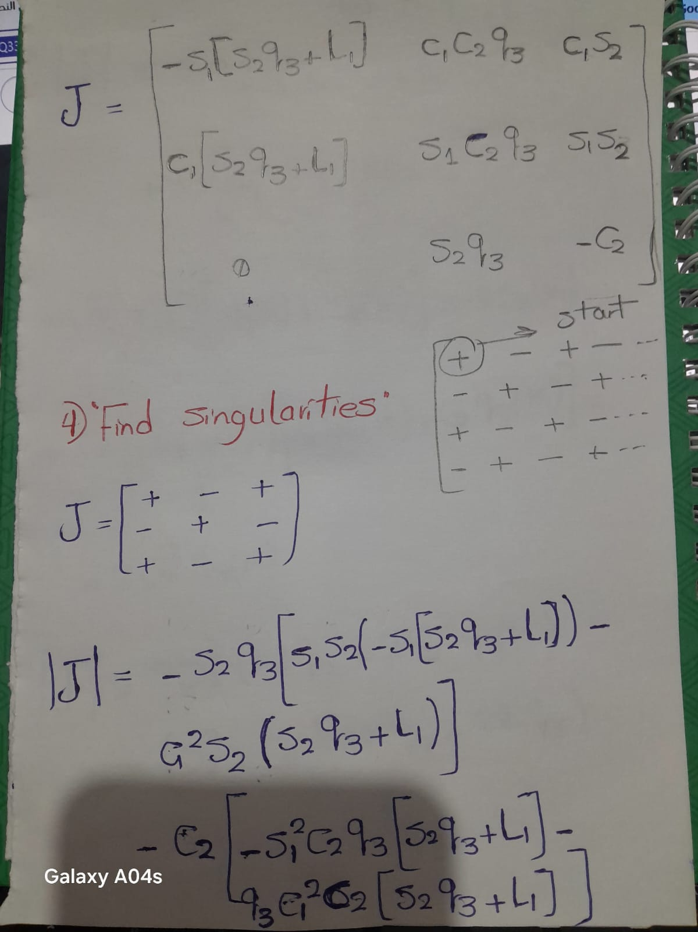

Slide 22
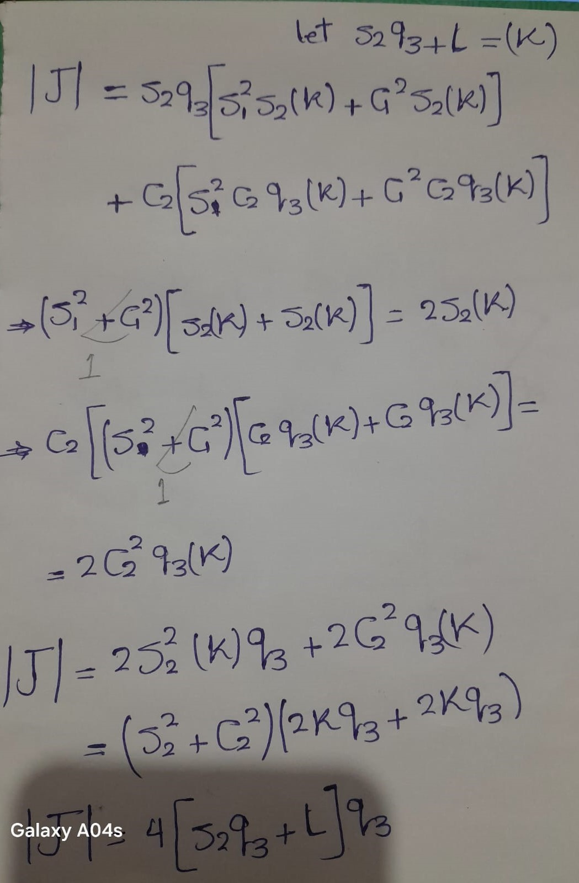

Slide 23
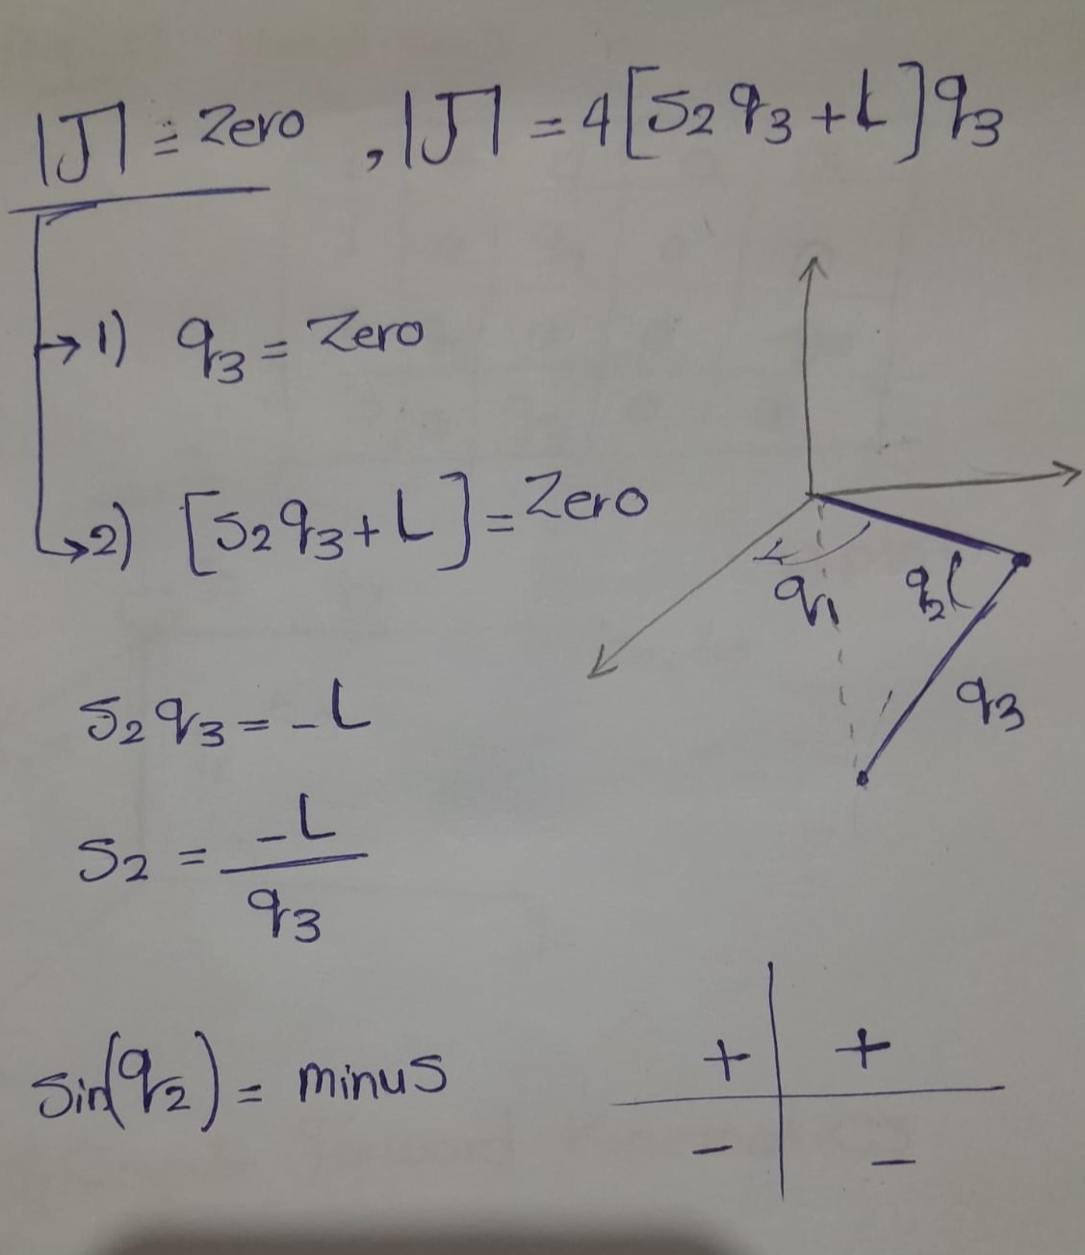

Slide 24
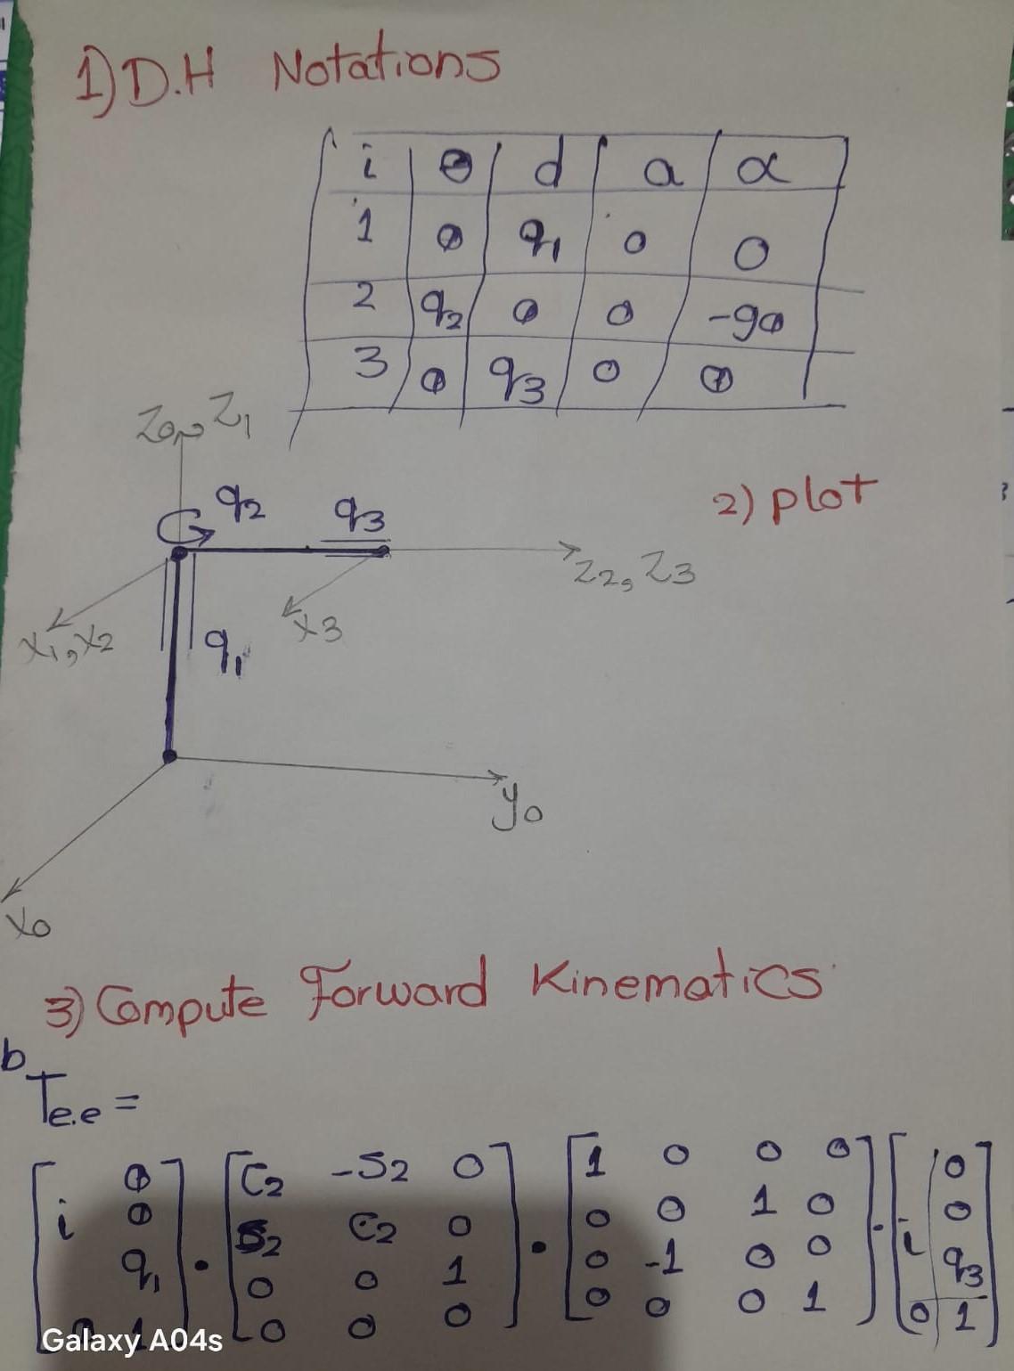

Slide 25
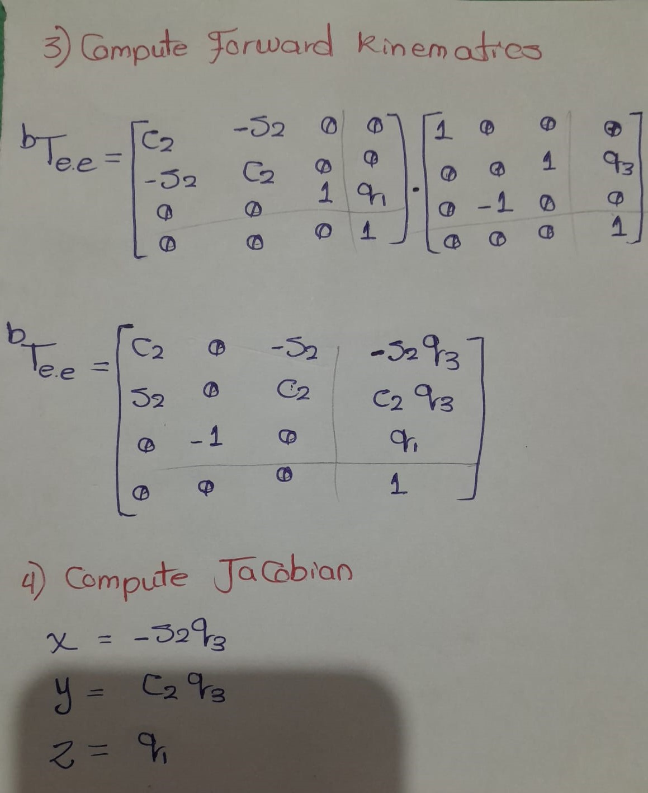

Slide 26
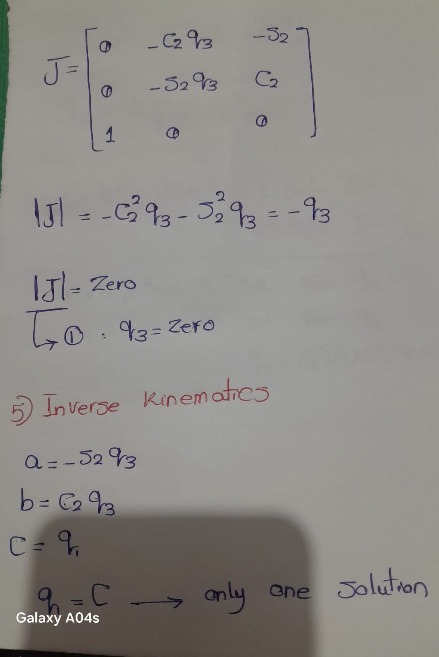

Slide 27
